Slide 1
AI Common Components
August 20, 2026
Notes:
The Province and Advanced Solutions have created an AI enabled application. This application enables the Housing Energy Savings Program which offers homeowners rebates for their housing improvements.
This software is not just AI-enabled. It was designed from the start with the intention to allow a core common component to be pulled out and reused. This core is a generic framework. This allows other in-development AI systems performing document compliance checks to quickly get up and running with enterprise AI best practices.

Slide 2
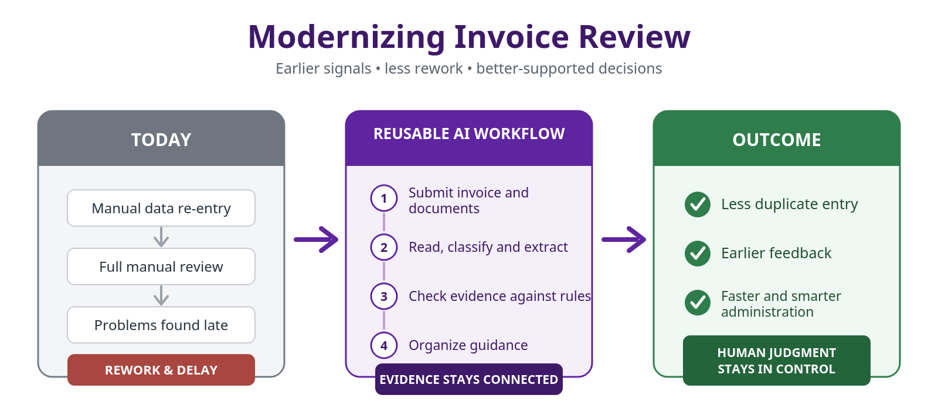
Notes:
What the ai actually does:
Uploads
Reads invoices and supporting documents
Recognizes document and upgrade types
Locates important facts across the complete package
Checks evidence against program requirements & Explains what passed, what needs attention and why
Suggests appropriate follow-up for incomplete cases then human edits.

Slide 3
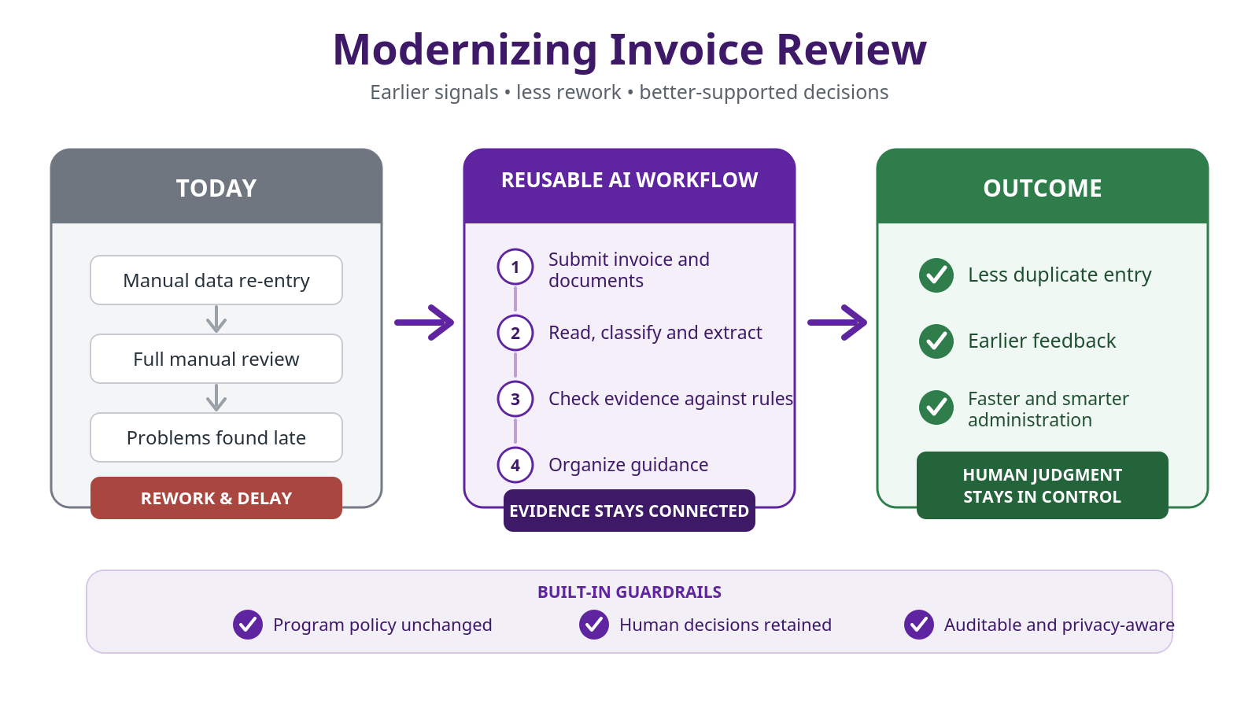
Notes:
What the ai actually does:
Uploads
Reads invoices and supporting documents
Recognizes document and upgrade types
Locates important facts across the complete package
Checks evidence against program requirements & Explains what passed, what needs attention and why
Suggests appropriate follow-up for incomplete cases then human edits.

Slide 4
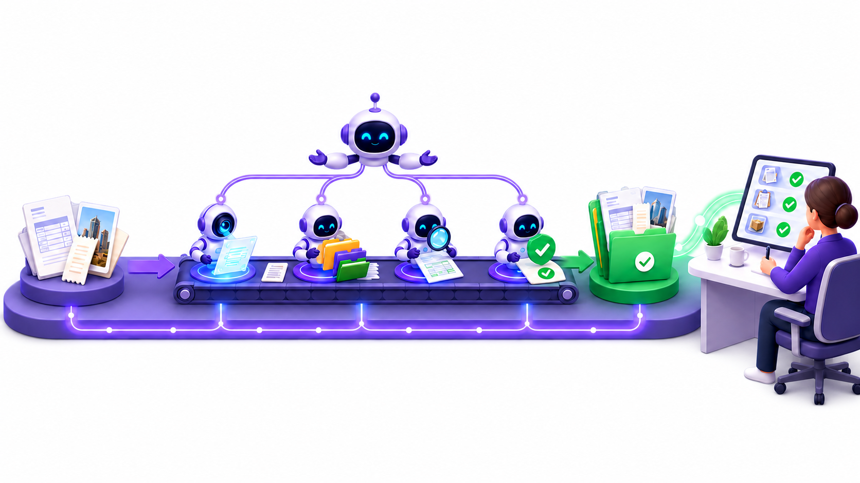

Slide 5
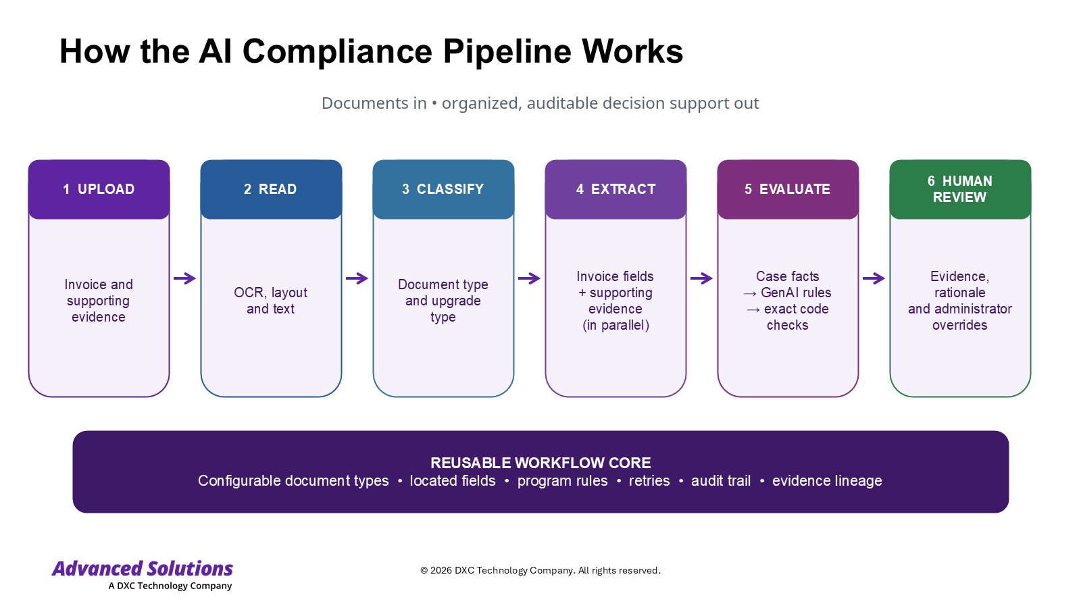
Notes:
What the ai actually does:
Uploads
Reads invoices and supporting documents
Recognizes document and upgrade types
Locates important facts across the complete package
Checks evidence against program requirements & Explains what passed, what needs attention and why
Suggests appropriate follow-up for incomplete cases then human edits.

Slide 6
Key Takeaways
Cost Savings via:
automated read,
early feedback,
ai guidance for faster & smarter evidence-based administration
Reusable common component for quick coding time and enterprise quality for your upcoming AI projects. The “Rules” themselves can be easily changed to any business line policy.
Human-controlled, evidence-backed and auditable
Notes:
Potential content re post go live learning:
Test the system using realistic invoice packages
Compare AI advice with actual administrative judgment
Identify false positives, missed evidence and unclear explanations
Improve guidance over time
KPIs: Define, Measure, Change, Repeat

Slide 7
DEMO

